Slide 1
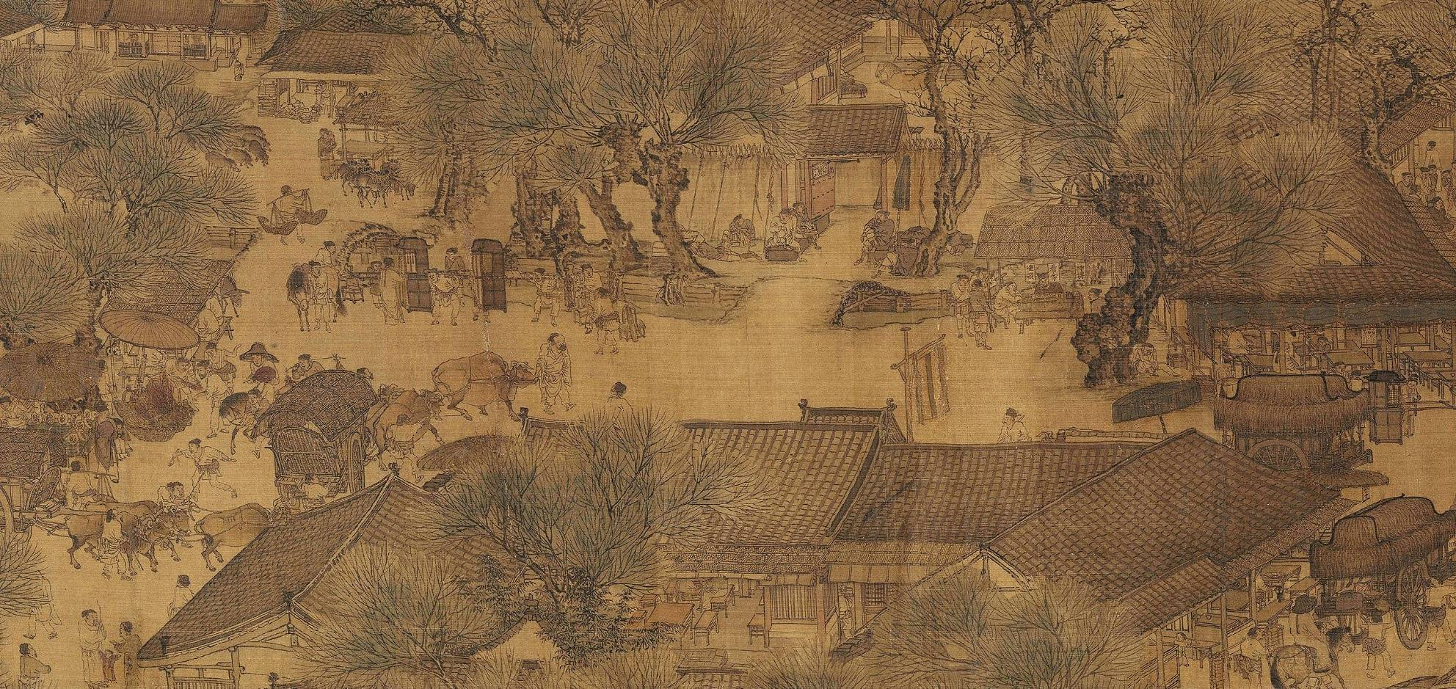
Welcome to Shenzhen logistics company

Slide 2




What do we do?
What are we?
We are in Shenzhen
we are a logistic company that :
shipping goods to all over the world,
store the goods for all over the world.

Slide 3

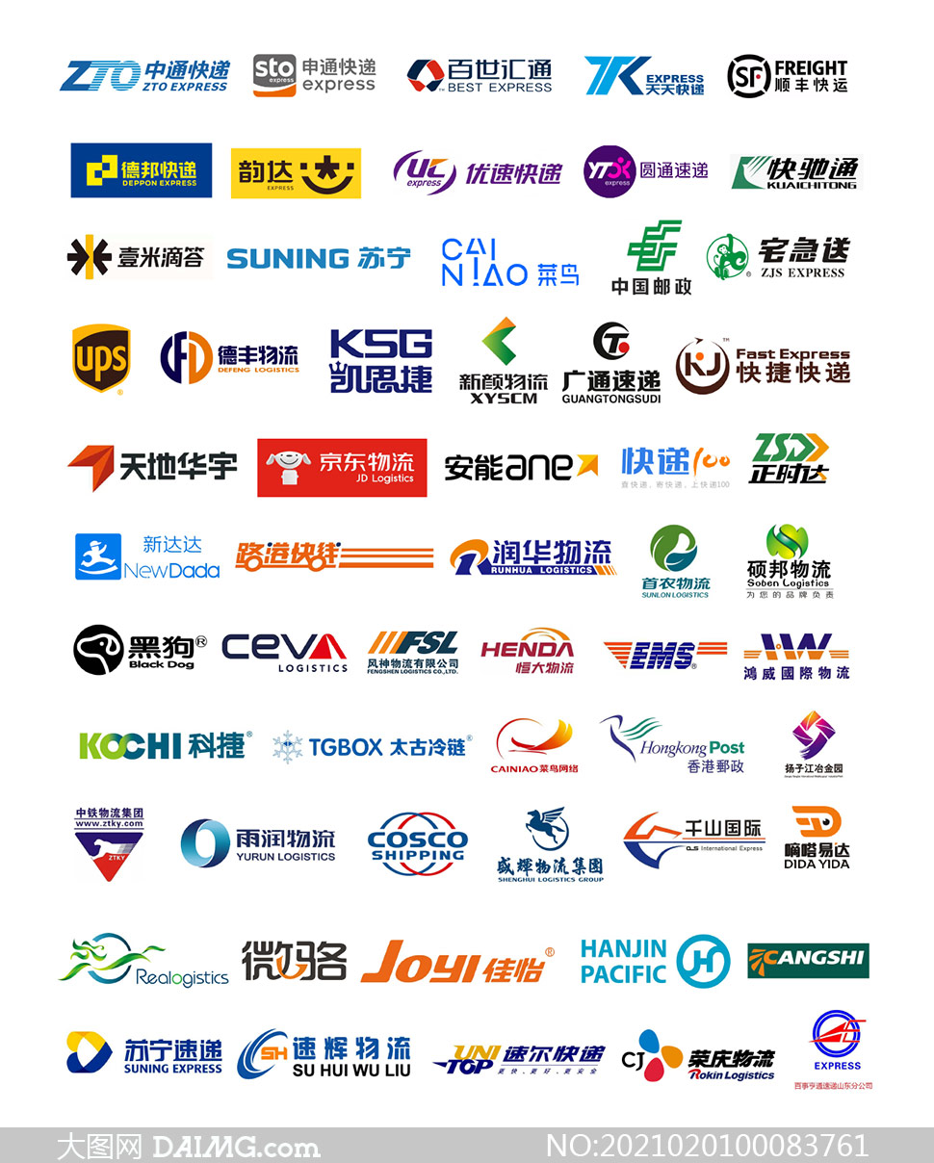
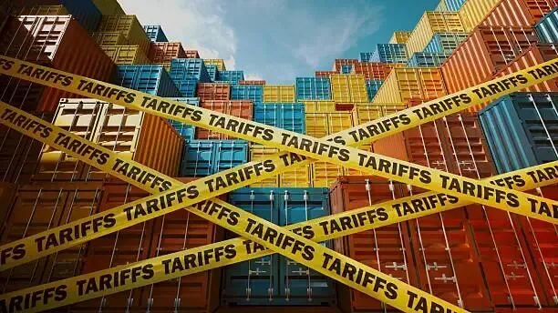
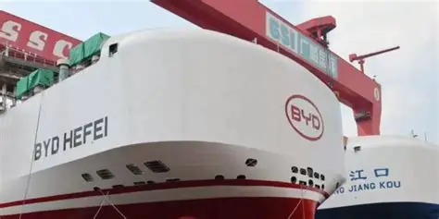
But now, we have to face some problem that could make difference to our fate
traffic blockade(tax) enterprise competition material price increace

Slide 4

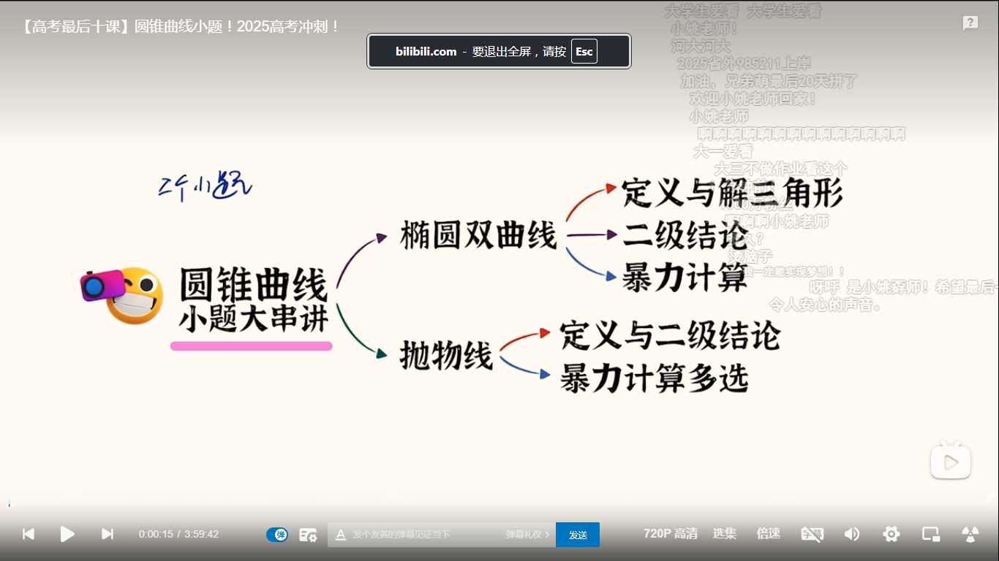
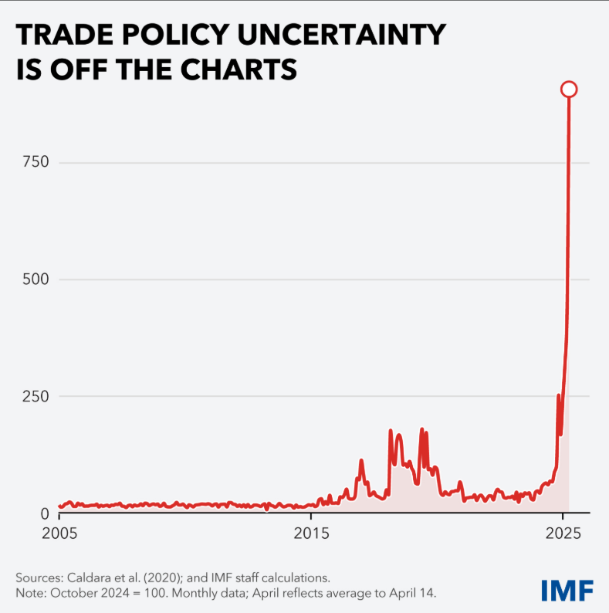
1.Globalization and economic fluctuations
😐
Trade policy uncertainty
😮
😢
A test of coping ability
Pros and cons of integration
The global trading system is undergoing a restructuring, and the uncertainty of trade policy has increased significantly, leading to increased volatility in financial markets.
Trade tensions and financial market fluctuations are testing the coping capabilities of logistics companies in various countries (including our company), and the damage to international trust has exacerbated the uneven impact of economic integration.
Economic integration has helped many people get
out of poverty, but it has also led to the loss of job
opportunities
and rising prices, increasing social inequality.
.etc
Together, these factors affect the stability and development prospects of the global economy

Slide 5
2.The impact of demographic changes and labor shortages
impact：
Reduced operational efficiency
solutions:
Introduce intelligent systems to optimize operational processes
Rising labor costs
Promote automation and optimize manpower allocation.
Decline in customer service quality
Strengthen customer service training and build feedback platforms.
Example: Jingdong Logistics Asia Warehouse No. 1 deployed more than 200,000 robots, the AI sorting efficiency was 300% higher than manual, and the unit storage cost was reduced from 2.8 yuan/piece to 1.9 yuan/piece.

Slide 6
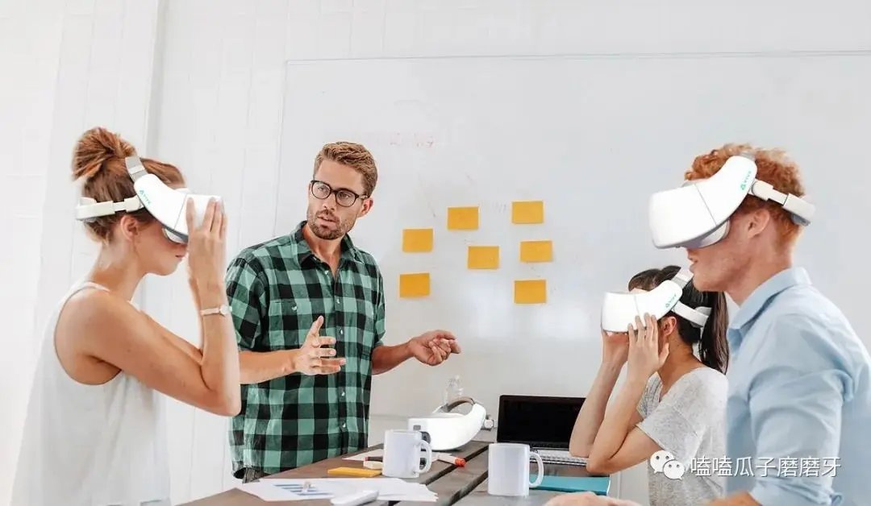
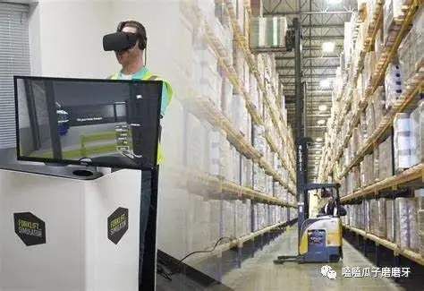
2.The impact of demographic changes and labor shortages
impact：
Reduced operational efficiency
solutions:
Introduce intelligent systems to optimize operational processes
Rising labor costs
Promote automation and optimize manpower allocation.
Decline in customer service quality
Strengthen customer service training and build feedback platforms.
A courier company established a ”newcomer mentor system" to shorten the training cycle of sorters from 7 days to 3 days through VR simulation training, and the retention rate increased by 12%.
VR培训在物流行业的应用 - 简书
This is a web link, tap it!

Slide 7
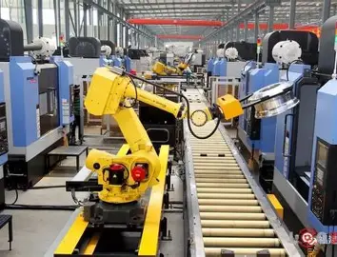
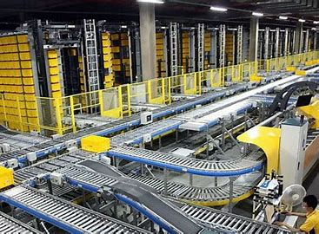
Technological progress
Therefore, with the advancement of automated sorting systems, the positive impacts we enjoy are also evident.
Here are our positive effects .
Highly automated

Slide 8
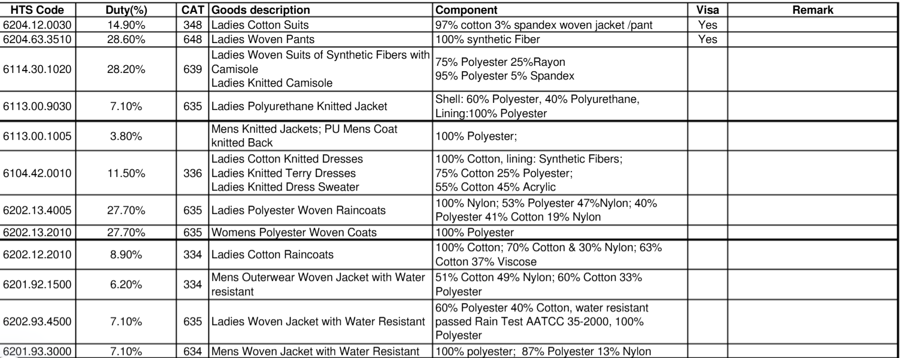
3. The impact of foreign tariff blockade
At the same time as economic globalization, a trade war has inevitably arisen. Surge in foreign tariffs on China
（1）Business Volume & Revenue – Plummeting Freight Demand to the US - Core Impact: Hit by tariff policies - Key Data: Container bookings from Asia to the US dropped by over 60% in one week
This is the US tariff on some Chinese goods

Slide 9
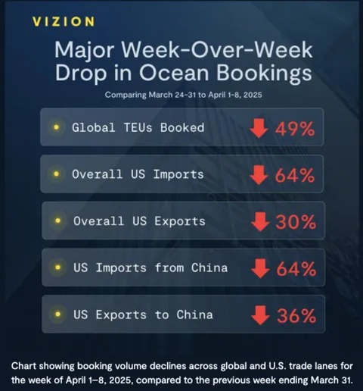
3. The impact of foreign tariff blockade
At the same time as economic globalization, a trade war has inevitably arisen. Surge in foreign tariffs on China
（2） Downward pressure on freight prices: Falling cargo volume is increasing competition, putting downward pressure on freight rates for key routes like US East and West coasts.

Slide 10
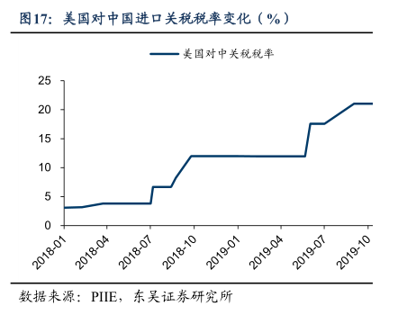
3. The impact of foreign tariff blockade
At the same time as economic globalization, a trade war has inevitably arisen. Surge in foreign tariffs on China
（3） Customer Order Cancellation or Suspension • Current Situation: Affected by high costs or uncertainties, many shippers choose to suspend shipments or even cancel orders 📦❌ • Core Reasons: High cost pressure, uncertainties in the market, logistics, etc. 📊⚠️

Slide 11

Use the tariff “window period” to accelerate shipments; accelerate the layout of overseas warehouses to avoid the risk of tariff fluctuations.
This is our solution
1.Seize the opportunity to establish overseas warehouses to reduce shipping costs and convert them into warehousing profits
2.Expand the market, not limited to a single country
Promote service branding and technological upgrades;
Expand into diversified markets to reduce reliance on any single market

Slide 12
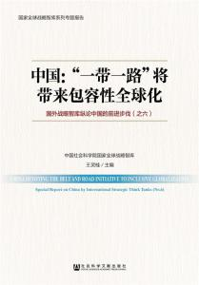
BUT！！！ there are still positive sides for us
According to this policy we can get these two thoughts that are benefit for us
http://eng.yidaiyilu.gov.cn/
This is a web link, tap it!
1.Reshuffle of the market pattern: seize opportunities in high-value markets The tariffs mainly hit products with low value-added and strong replaceability. But this has instead prompted China's export structure to tilt towards products with high value-added, high timeliness, and high brand requirements, such as electronic products, new energy products, and smart homes.

Slide 13
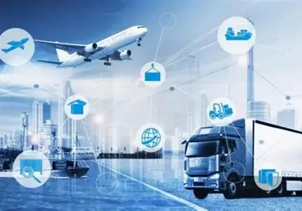
BUT！！！ there are still positive sides for us
Global network layout: Opportunities from "Sino-US Dedicated Line” to "Global Network Weaving”
🌍 Explore Emerging Markets Focus on Belt and Road countries, Southeast Asia, Middle East, and Latin America.
🕸️ Build a Diversified Network Open new international routes and set up regional hubs for a stronger global logistics network.
🚀 Support Chinese Brands Going Global Offer end-to-end logistics solutions worldwide—not just single routes to the U.S.

Slide 14
4. Regarding the increasing awareness of risks and safety in the logistics industry, people are becoming more aware of risks and safety.
impact：
? ? ? ?
Customers are demanding higher logistics quality standards. Operating costs are rising.
For example, large logistics companies such as SF express and
DHL have passed TAPA certification to obtain high-end customer groups.
solution：
(2)Using digital tools like AI analytics and IoT tracking enables real-time visibility into goods' safety. For instance, SF Express equips high-value shipments with smart tags that monitor not only location but also temperature, humidity, vibration, and light exposure.
(3) Deploy firewalls to strengthen network security training to protect customer privacy and security

Slide 15

Currently
our company
Encountered impacts
but we have solutions
And many opportunities
As a logistic company
First, we should reach out to the needs of all over the world, expand business and markets, and diversified market windows
Second, prioritizing timeliness and delivering service with utmost sincerity.
Third,we can expand our business horizons such as transforming into “supply chain consultants” for customers.
May we becoming the industry leader in the years to come!

Slide 16
Thanks for watching！

Slide 17
这是一首小组件

